Slide 1

Using “Machine Learning” (a.k.a statistics) to estimate the unknown

Slide 2
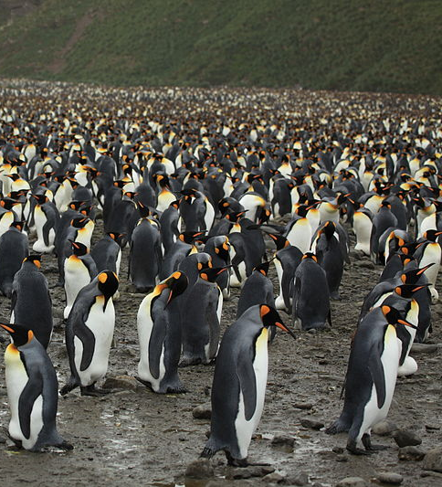
Where we are
All of this is to figure out what the population size is
Fundamental for conserving/managing a species
To do this we need to estimate two parameters
The capture rate (p)
The number never encountered (f₀)
Previously we just assumed the values of these
But in reality MLE does this
We will inevitably run different versions of these models
How do we choose which hypothesis best matches the observations?
Is it M_{o}, M_{t}, M_{h}, M_{b}, etc.?

Slide 3
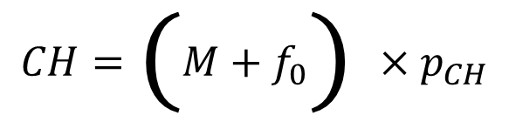
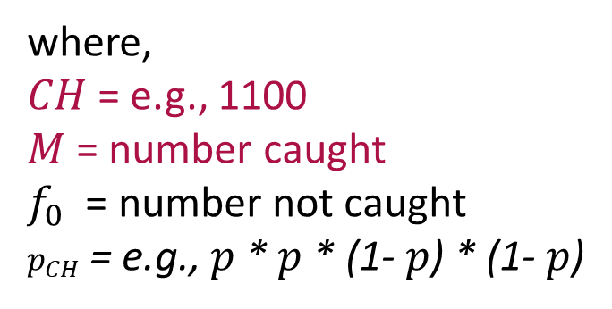
Closed CMR; statistics and data
$$y = mx + c$$
$$CH=\left(M+f_{0}\right)×p_{CH}$$
where,
$CH$ = e.g., 1100
$M$ = number caught
$f_{0}$ = number not caught
$p_{CH}$ = e.g., $p$ * $p$ * (1- $p$) * (1- $p$)
Note that this is a huge simplification!
Observed
Data
Unobserved
“Parameter”

Slide 4
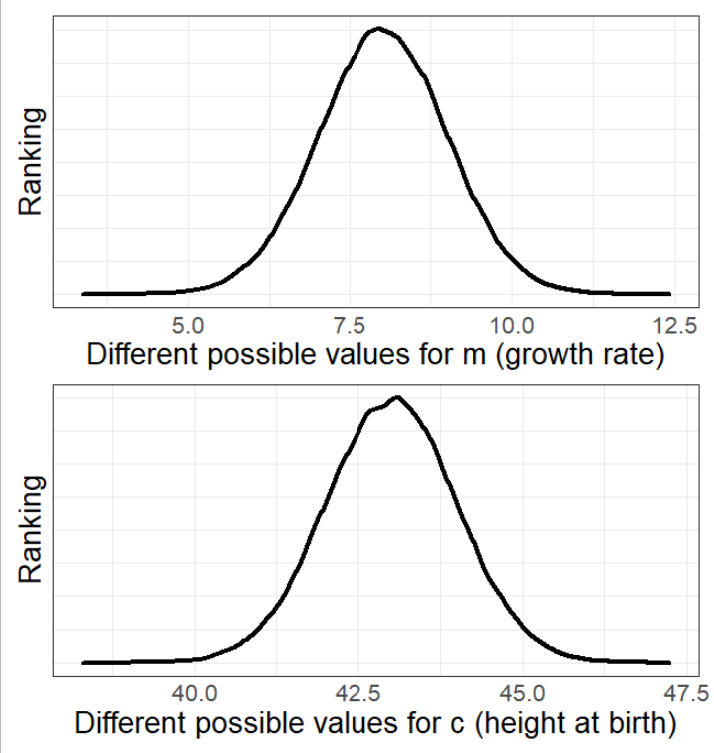
How does Maximum Likelihood Estimate work?
Previously I said;
‘The “algorithm” tries many different possible values for all parameters.’
But that’s not very satisfying.
What follows is very complex.
I do not expect you to understand, I just want to give you an idea of how the engine works.

Slide 5
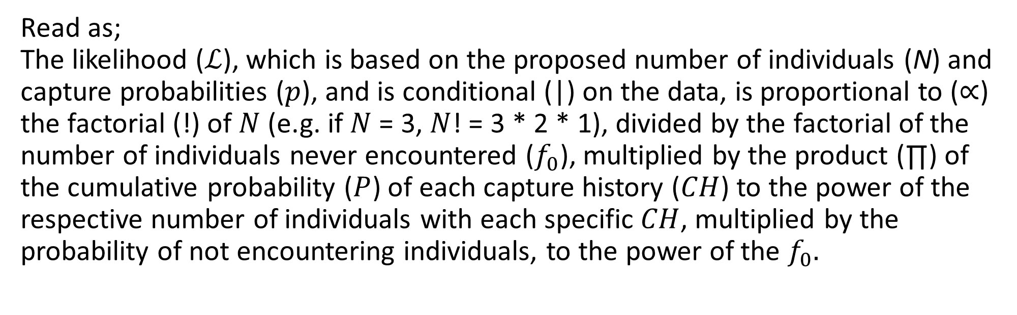
Behind the scenes
The “rating” (a.k.a. the Likelihood) equation
$$ℒ\left(N,p | data\right)∝\frac{N!}{f_{0}!}\prod_{CH}{P{\left[CH\right]}^{n_{CH}}}∗P{\left[not encountered\right]}^{f_{0}}$$
Read as;
The likelihood ($ℒ$), which is based on the proposed number of individuals (N) and capture probabilities ($p$), and is conditional (|) on the data, is proportional to ($∝$) the factorial (!) of $N$ (e.g. if $N$ = 3, $N$! = 3 * 2 * 1), divided by the factorial of the number of individuals never encountered ($f_{0}$), multiplied by the product (∏) of the cumulative probability ($P$) of each capture history ($CH$) to the power of the respective number of individuals with each specific $CH$, multiplied by the probability of not encountering individuals, to the power of the $f_{0}.$

Slide 6
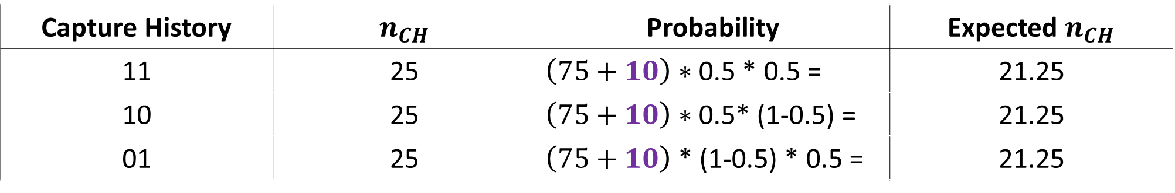
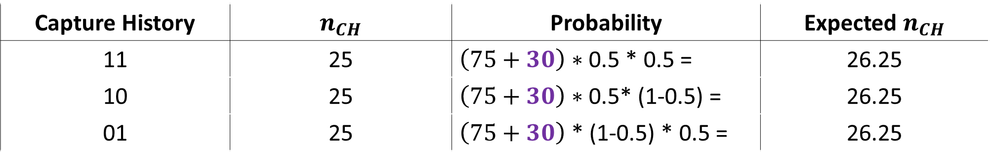
Let’s calculate MLE
Let’s try assuming $f_{0}$ is 10 (i.e. we failed to encounter 10 animals)
Capture History | $n_{CH}$ | Probability | Expected $n_{CH}$
11 | 25 | $\left(75+10\right)∗$ 0.5 * 0.5 = | 21.25
10 | 25 | $\left(75+10\right)∗$ 0.5* (1-0.5) = | 21.25
01 | 25 | $\left(75+10\right)$ * (1-0.5) * 0.5 = | 21.25
How about assuming $f_{0}$ is 30
Capture History | $n_{CH}$ | Probability | Expected $n_{CH}$
11 | 25 | $\left(75+30\right)∗$ 0.5 * 0.5 = | 26.25
10 | 25 | $\left(75+30\right)∗$ 0.5* (1-0.5) = | 26.25
01 | 25 | $\left(75+30\right)$ * (1-0.5) * 0.5 = | 26.25

Slide 7


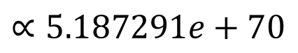
When $f_{0}$ = 10 and $p$ = 0.5
$$ℒ\left(N,p | data\right)∝\frac{N!}{f_{0}!}\prod_{CH}{P{\left[CH\right]}^{n_{CH}}}∗P{\left[not encountered\right]}^{f_{0}}$$
$$∝\frac{85!}{10!}\prod_{CH}{(0.25{\left[{CH}_{11}\right]}^{25}}∗ 0.25{\left[{CH}_{10}\right]}^{25} ∗ 0.25{\left[{CH}_{01}\right]}^{25}) ∗0.25{\left[{CH}_{00}\right]}^{10}$$
$$∝7.763184e+121 ∗6.681912e−52$$
$$∝5.187291e+70$$
$$∝51,872,910,000,000,002,$$
$626,644,064,642,484,628,$
$620,480,602,880,426,460,$
$084,042,624,462,424,266$

Slide 8
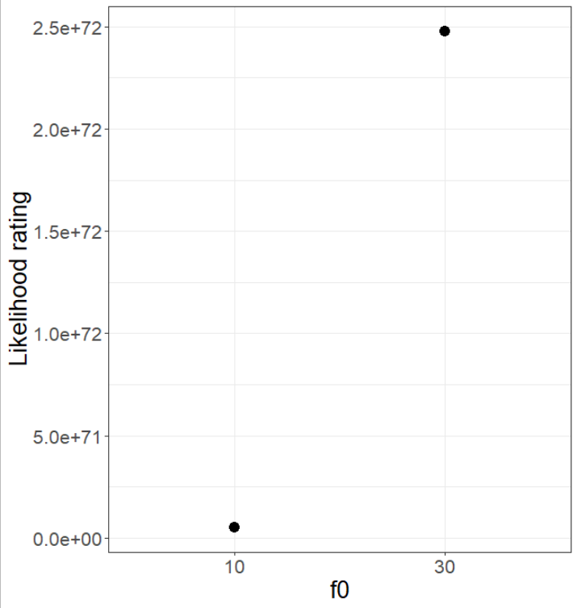
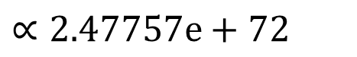

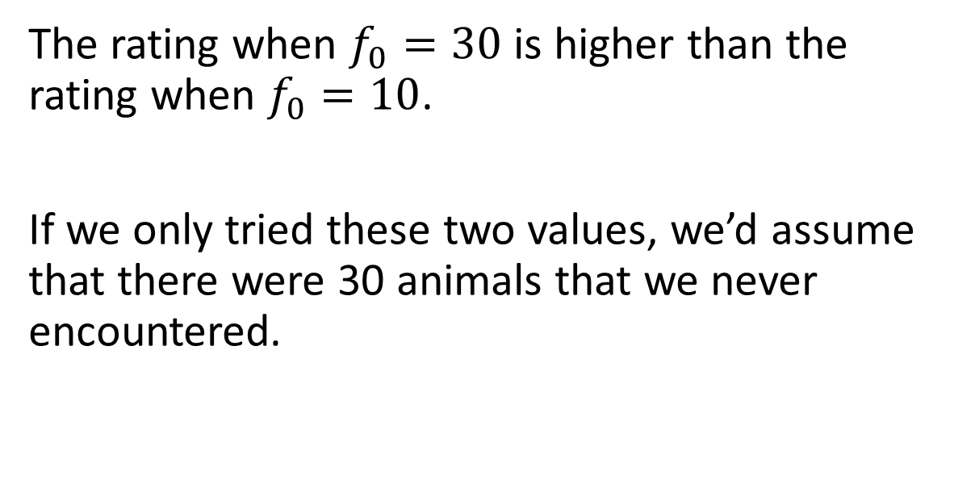
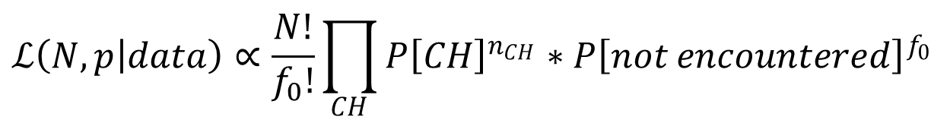
When $f_{0}$ = 30 and $p$ = 0.5
$$ℒ\left(N,p | data\right)∝\frac{N!}{f_{0}!}\prod_{CH}{P{\left[CH\right]}^{n_{CH}}}∗P{\left[not encountered\right]}^{f_{0}}$$
$$∝2.47757e+72$$
The rating when $f_{0}=30$ is higher than the rating when $f_{0}=10$.
If we only tried these two values, we’d assume that there were 30 animals that we never encountered.

Slide 9
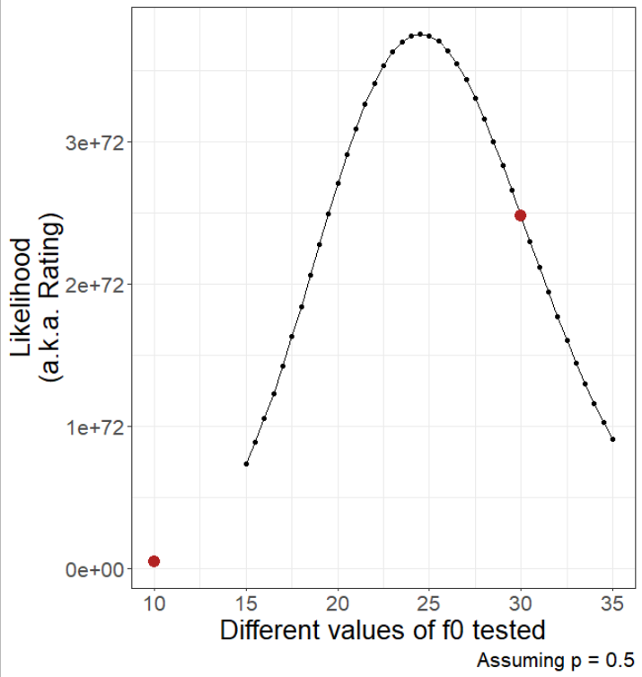
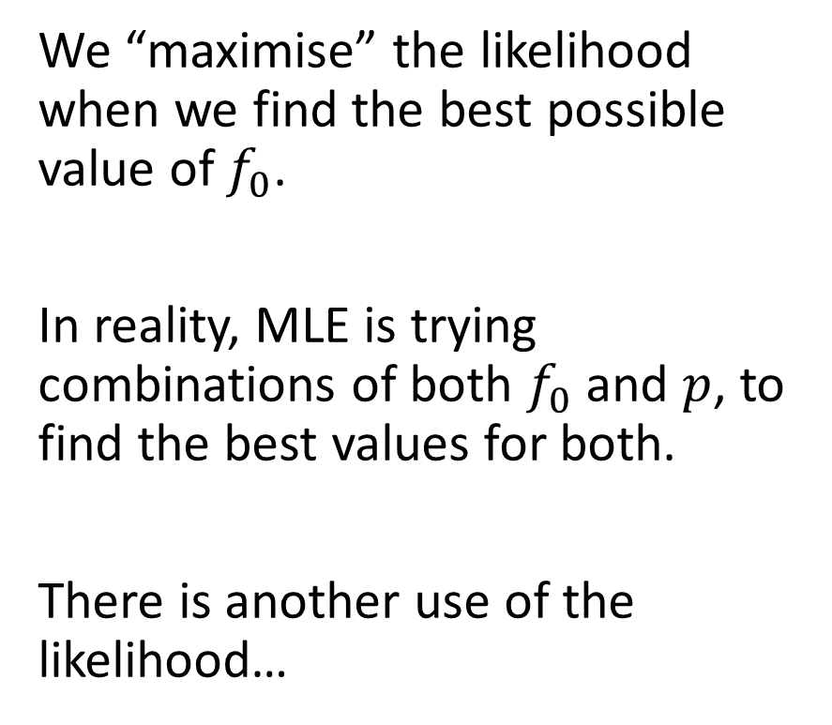
Letting MLE do it’s thing
We “maximise” the likelihood when we find the best possible value of $f_{0}$.
In reality, MLE is trying combinations of both $f_{0}$ and $p$, to find the best values for both.
There is another use of the likelihood…

Slide 10

Which model best fits our data?
When running analysis, you will invariably have multiple models, all trying to explain the same pattern, e.g.,
M_{o}
M_{t}
M_{h}
M_{b}
Out of all the models that we’ve run, how do we choose the best model?
AIC
“An Information Criteria”
“Improperly” called Akaike’s Information Criteria
He never named it after himself
赤池 弘次, Akaike Hirotsugu

Slide 11
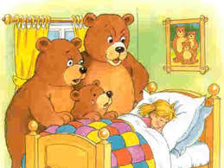
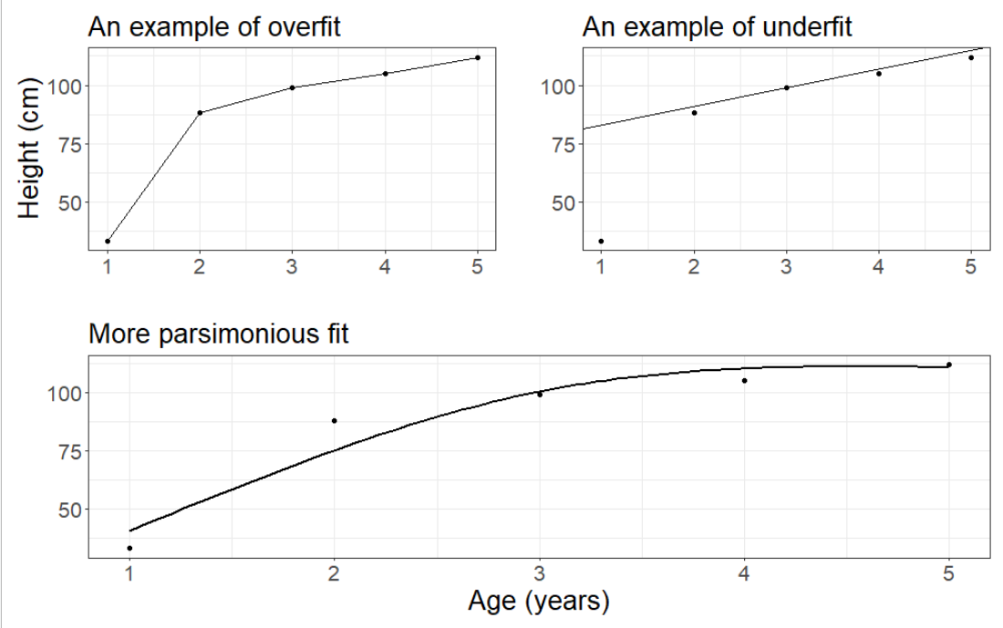
Overfitting and underfitting
Overfit:
Explains data almost “perfectly”
I.e. prediction (line) goes through each observation
But “costs” lots of parameters
E.g. here we’ve used 5 parameters with only 5 observations
Underfit:
Explains poorly
I.e. prediction (line) doesn’t really match the observations
But is very “cheap”
E.g. here we’ve used 2 parameters with only 5 observations

Slide 12
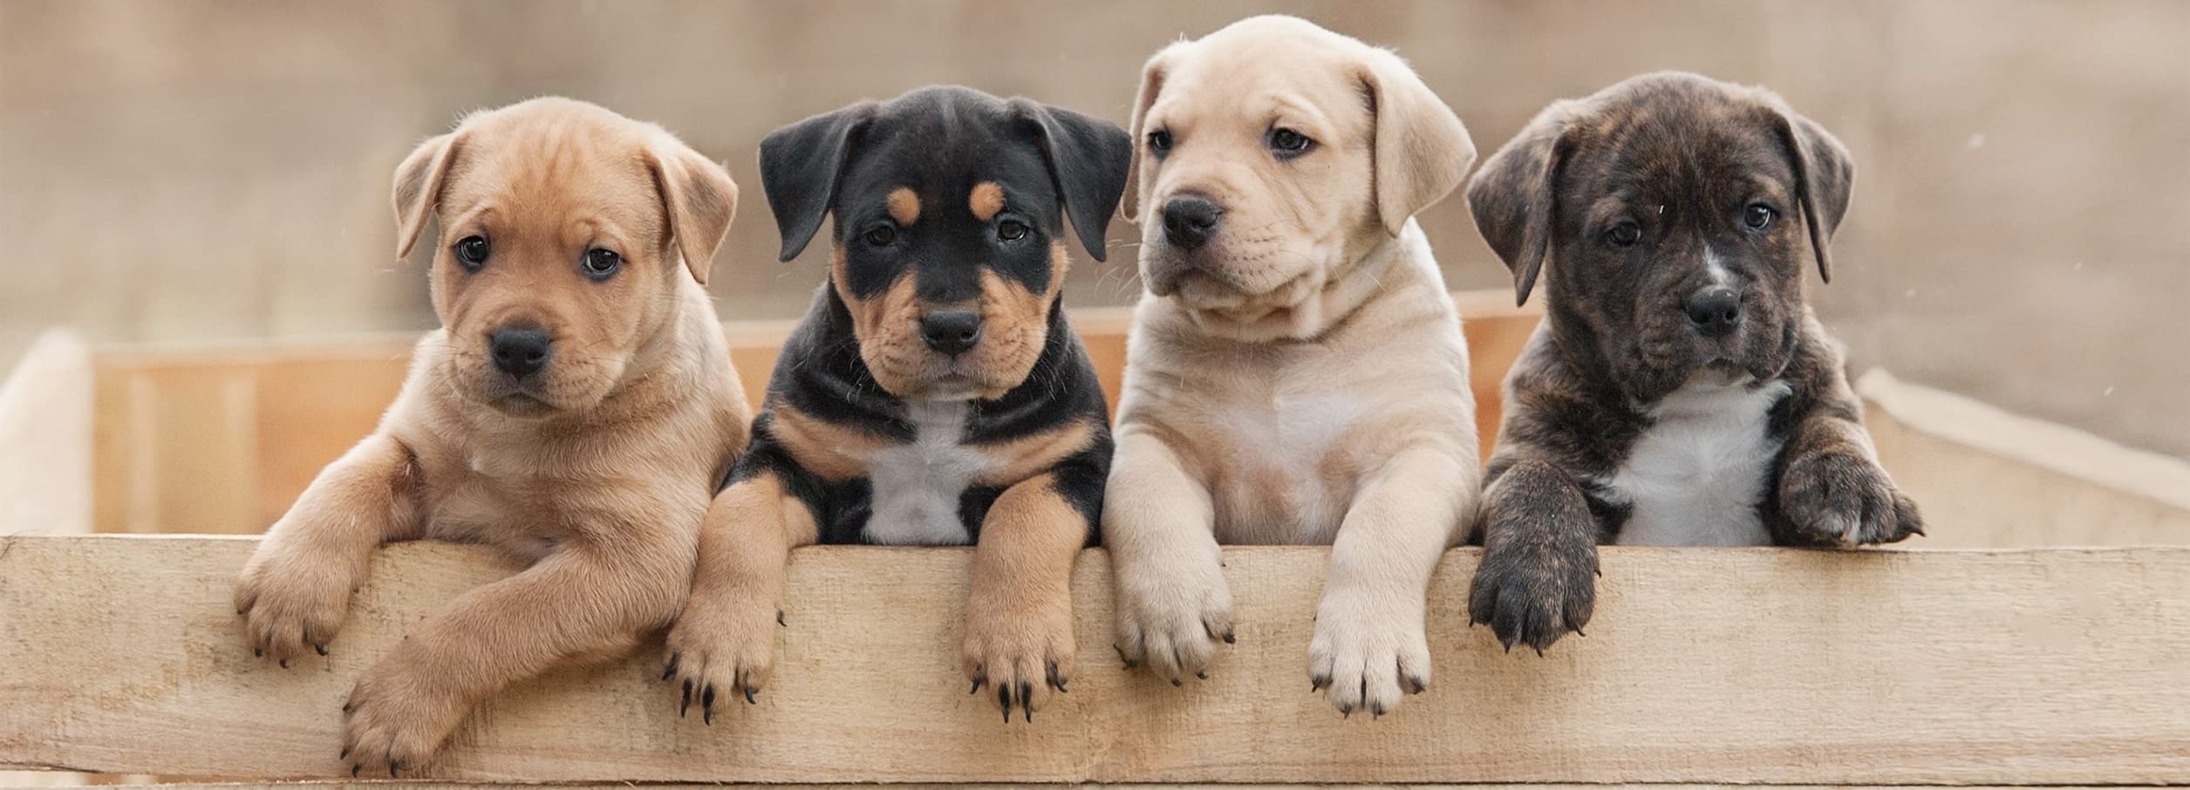
Using AIC to find most “parsimonious” model
To do so, we use the best Likelihood value (“rating”) for each of the different models that we’ve run.
Though we need to tweak the Likelihood
(More equations are coming)

Slide 13
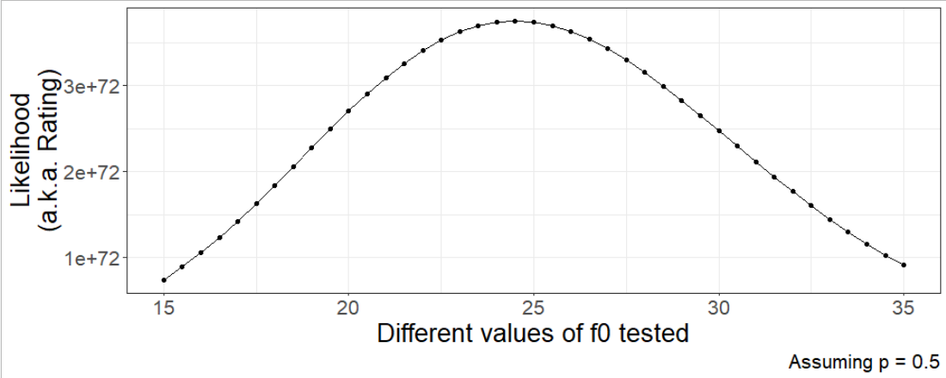
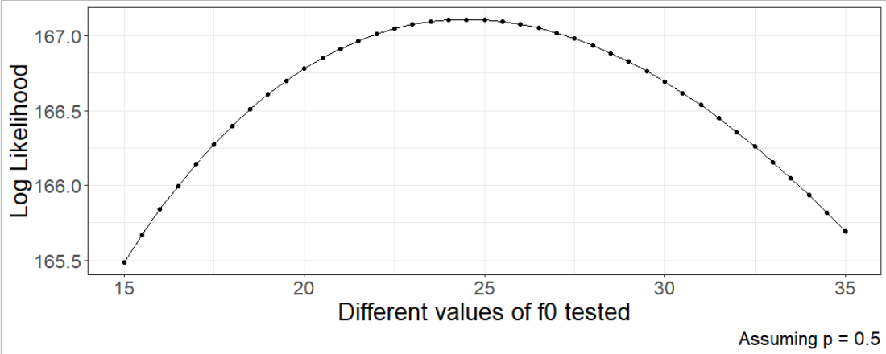
From Likelihood to Log-Likelihood
First, log transform the likelihood:

Slide 14
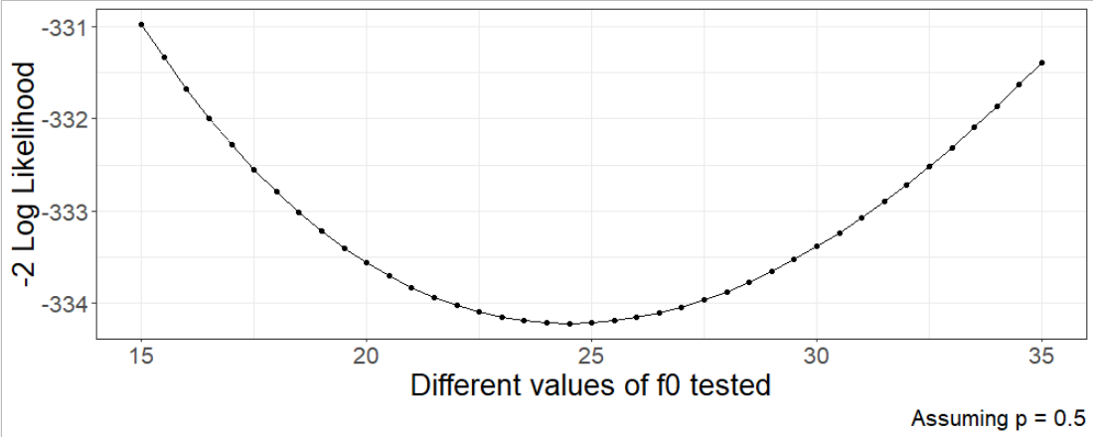
From Log-Likelihood to -2*Log-Likelihood
Then, multiply the log transform by -2:

Slide 15
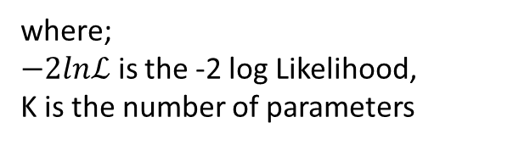

Savvy shoppers
Keep the -2LogLikelihood in the back of your mind for a second
We want to be “savvy shoppers”
We’re aiming to get the best value-for-money item
We’ll use -2LogLikelihood as our ranking for each “item” (i.e. model)
We’ll say the £price is the cost (i.e. number of parameters)
$$AIC=−2lnℒ+2K$$
where;
$−2lnℒ$ is the -2 log Likelihood,
K is the number of parameters

Slide 16



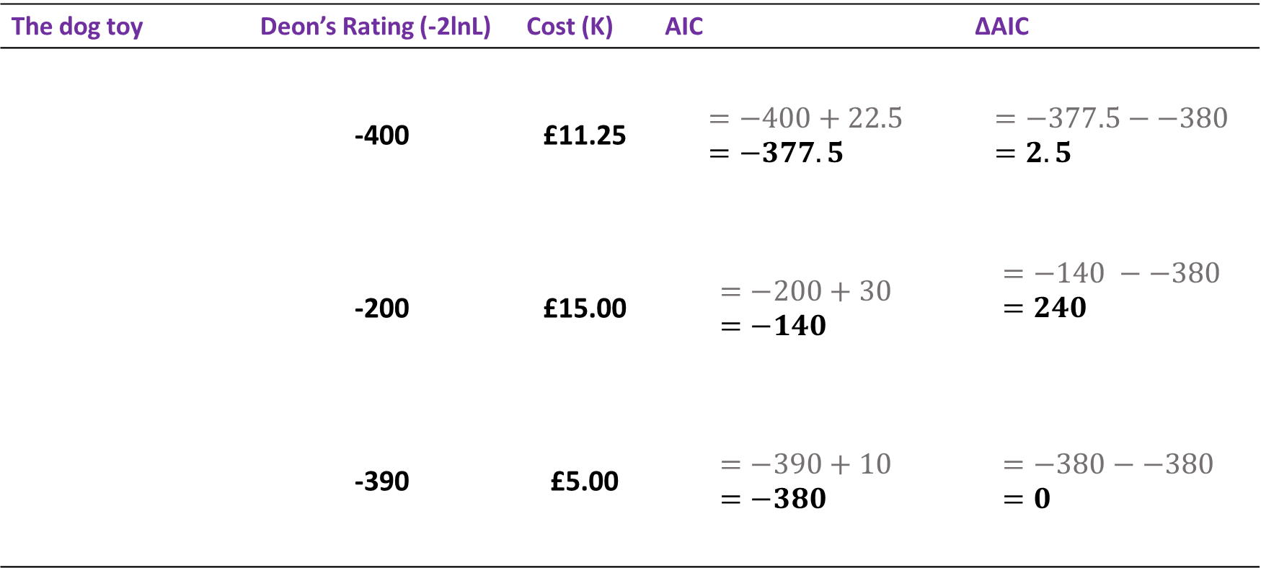

Let’s buy some dog toys
The dog toy | Deon’s Rating (-2lnL) | Cost (K) | AIC | ∆AIC
 | -400 | £11.25 | $$=−400+22.5 =−377.5$$ | $$=−377.5−−380=2.5$$
 | -200 | £15.00 | $$=−200+30 =−140$$ | $$=−140 −−380=240$$
 | -390 | £5.00 | $$=−390+10 =−380$$ | $$=−380−−380 =0$$
$$AIC=−2lnℒ+2K$$

Slide 17
Model selection with AIC
We always choose the model with the lowest AIC
This will be the model where ∆AIC = 0
Any models with ∆AIC > 2, we reject them
If there is a model with ∆AIC < 2, both model are valid.
Of those two models, you choose which one to use
Always run the simplest possible model!!!
No more p-values!

Slide 18
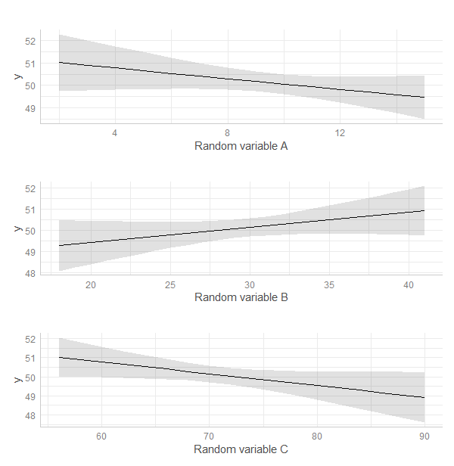
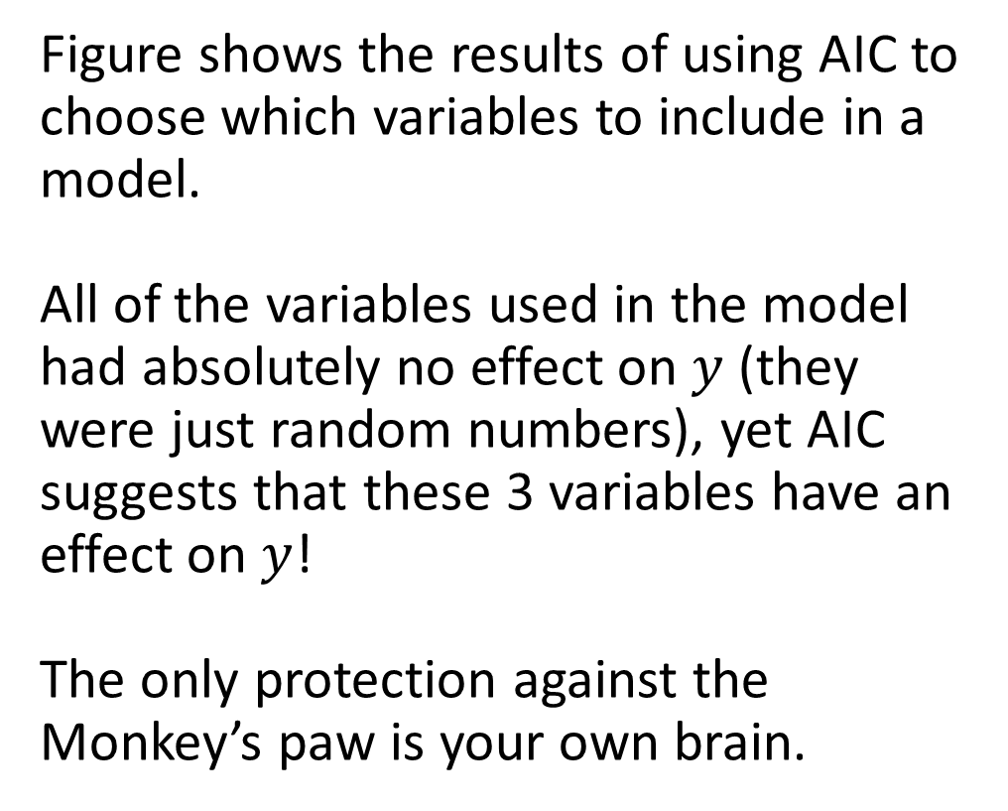
No amount of clever statistics can save you from the Monkey’s paw!
Figure shows the results of using AIC to choose which variables to include in a model.
All of the variables used in the model had absolutely no effect on $y$ (they were just random numbers), yet AIC suggests that these 3 variables have an effect on $y$!
The only protection against the Monkey’s paw is your own brain.

Slide 19

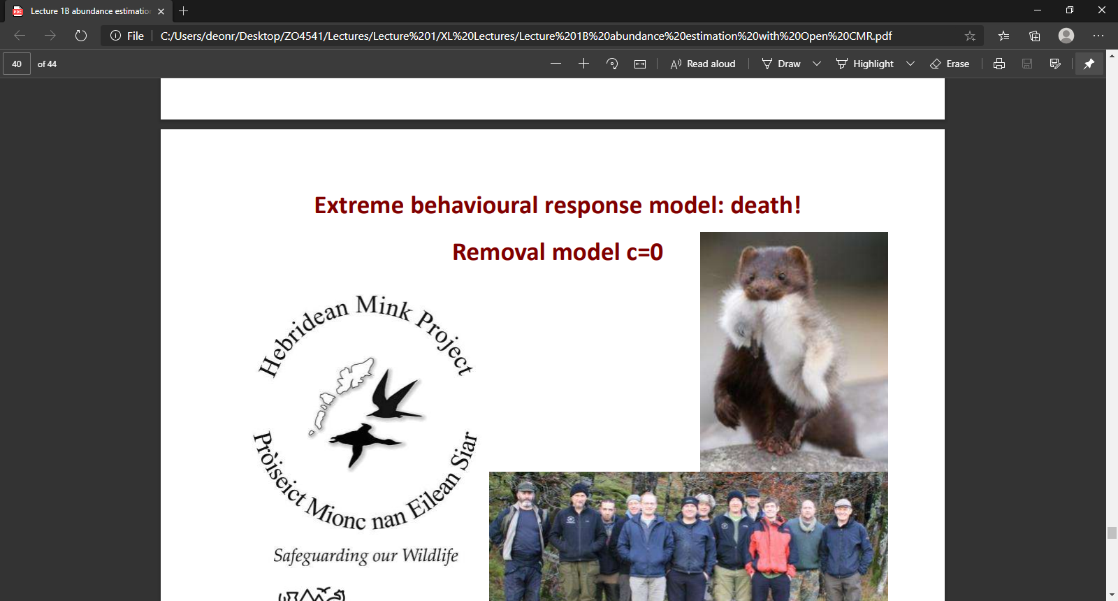

Bring it all together
American mink in the Hebrides
Mink “escaped” fur farms in 1960’s
Spread all over Scotland and reached South Uist in 2001
Any captured mink are eradicated

Slide 20
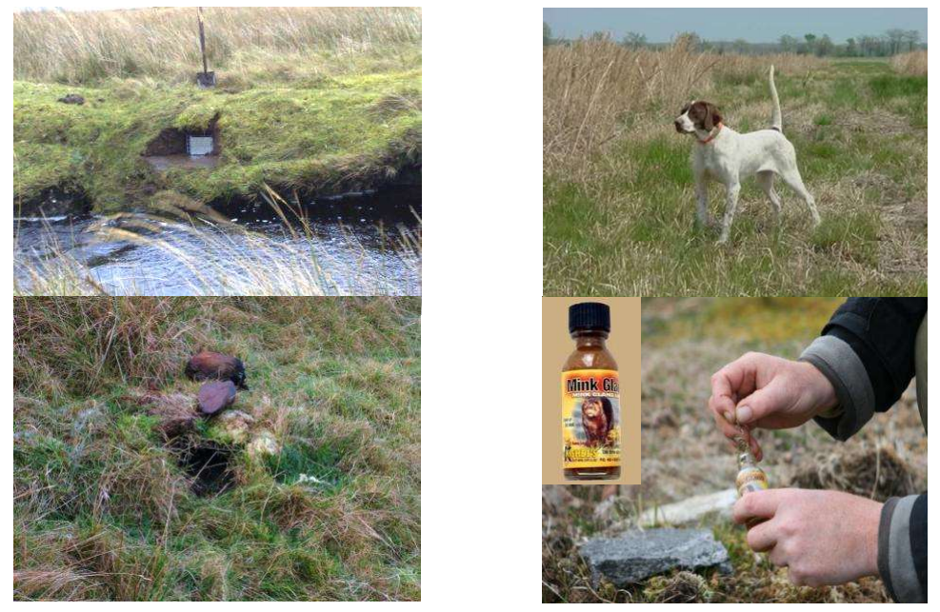
7,500 mink traps operated by 14 staff

Slide 21
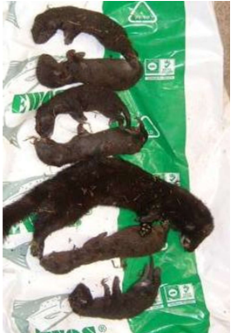
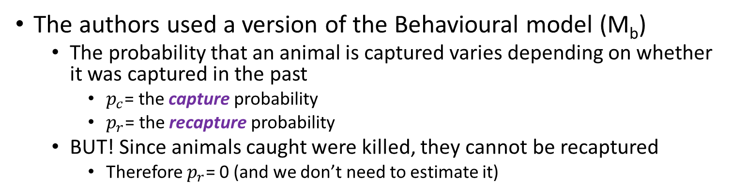

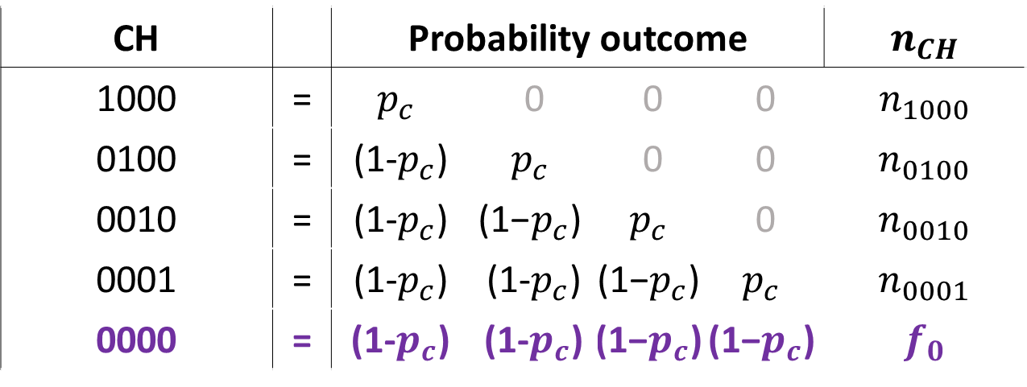
A Closed CMR model to estimate $\hat{N}$
The authors used a version of the Behavioural model (M_{b})
The probability that an animal is captured varies depending on whether it was captured in the past
$p_{c}$= the capture probability
$p_{r}$= the recapture probability
BUT! Since animals caught were killed, they cannot be recaptured
Therefore $p_{r}$= 0 (and we don’t need to estimate it)
CH |  | Probability outcome | Capture prob | Capture prob | Capture prob | $n_{CH}$
1000 | = | $$p_{c}$$ | 0 | 0 | 0 | $n_{1000}$
0100 | = | (1-$p_{c}$) | $$p_{c}$$ | 0 | 0 | $n_{0100}$
0010 | = | (1-$p_{c}$) | $$\text{(1−}p_{c}\text{)}$$ | $$p_{c}$$ | 0 | $n_{0010}$
0001 | = | (1-$p_{c}$) | (1-$p_{c}$) | $$\text{(1−}p_{c}\text{)}$$ | $$p_{c}$$ | $n_{0001}$
0000 | = | (1-$p_{c}$) | (1-$p_{c}$) | $$\text{(1−}p_{c}\text{)}$$ | $$\text{(1−}p_{c}\text{)}$$ | $f_{0}$

Slide 22
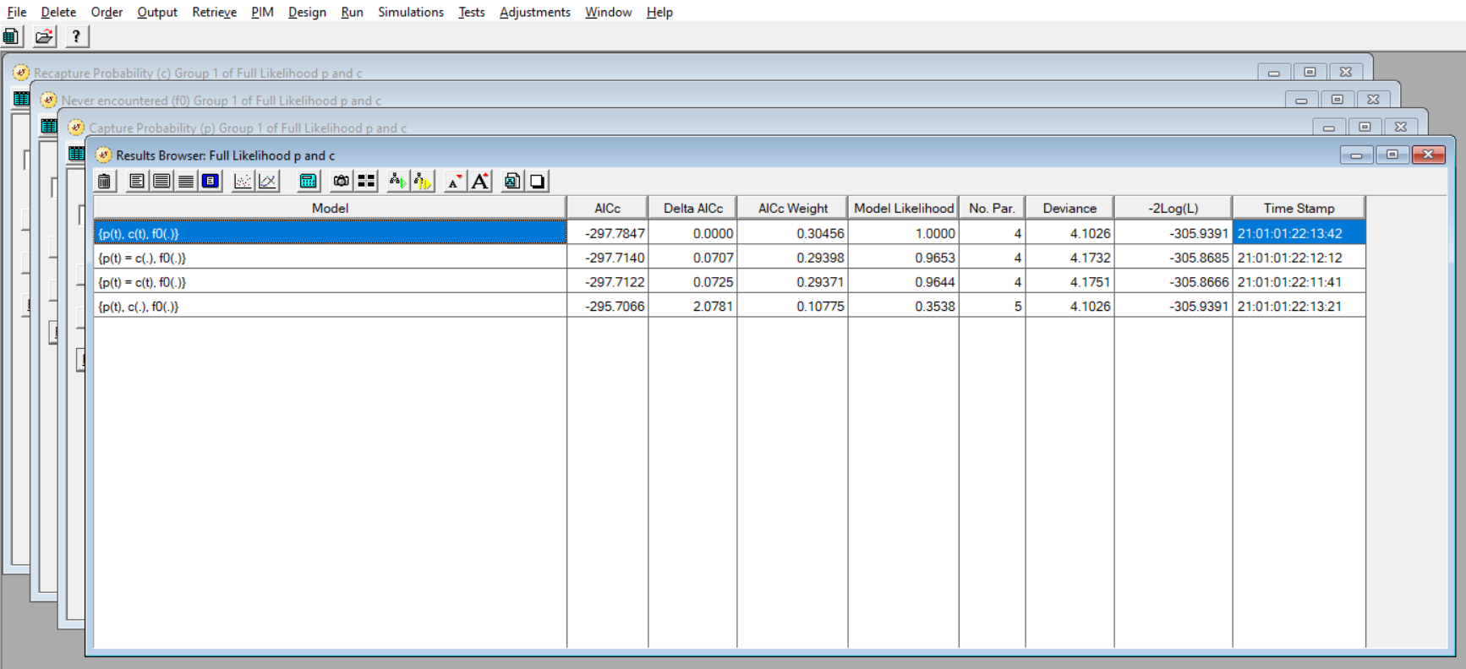
Programme MARK software

Slide 23
tl;dr
Maximum Likelihood Estimation is just an equation that ratesdifferent parameter values to give the most plausible version of that specific model, conditional on the data.
We can also then use the best likelihood, of all models tested, to do model selection.
We do so by using the model with the LOWEST AIC.
Any competing models where ∆AIC < 2, we cannot distinguish between the two different models.
AIC is a method to distinguish between models, but it doesn’t mean you can turn your brain off!

